Slide 1
Intelligent Battery Management
PIP104 PROFESSIONAL PRACTICE-II
VIVA-VOCE
Batch Number: CSD37
Roll Number | Student Name
20201CSD0215 | PRIYANSHU RAJ
20201CSD0082 | CHOVATIYA PARTH MAHESHBHAI
20201CSD0100 | VASOYA RUSHI GIRDHARBHAI
Under the Supervision of,
Dr. V Chandra Sekar
School of Computer Science & Engineering
Presidency University

Slide 2
Introduction
In the fast-paced world of today, vehicle reliability is essential. Unexpected breakdowns caused by battery issues can disrupt busy schedules and leave individuals stranded. To address this challenge, an innovative user-friendly battery management tool that provides real-time insights into a vehicle's battery health and state of charge (SOC) is proposed. This user-friendly tool empowers individuals with the knowledge necessary to maintain their batteries and prevent unexpected breakdowns. The battery management model provides real-time insights into the battery's SOC, indicating the remaining charge level. This information is crucial for planning trips and ensuring the battery has enough power to start the vehicle. Beyond SOC, it also provides valuable information about the battery's state of health (SoH). SoH indicates the overall health and capacity of the battery. Understanding SoH helps individuals anticipate when the battery may need replacement, allowing them to take proactive measures to prevent unexpected breakdowns. In addition to providing comprehensive information, the battery management tool also offers personalized recommendations to prolong battery life. The user-friendly battery management model aims to inform individuals about the state of their vehicle's battery and to empower them to take steps to optimize battery health and performance, thereby prolonging battery life and ensuring reliable transportation.

Slide 3
Literature Review
SOH Estimation Using Decision Tree and Improved SVM Regression
Since the model uses Decision Trees it can be prone to overfitting, especially when the tree is deep. This might lead to poor generalization on data outside the training set. The performance of these models heavily depends on the quality and relevance of the input features. If important features are missing or if irrelevant features are included, the model's accuracy may suffer.
Robust SOH Prediction Model for Electric Vehicle Batteries
Robust models often involve increased complexity to handle diverse scenarios and uncertainties. This complexity may make the model harder to interpret and implement. Achieving robustness may require computationally intensive techniques, especially if the model incorporates advanced algorithms or ensemble methods. This could impact real-time applications or resource-constrained environments.
Driving Range Prediction Using Gradient Boosting Decision Tree
GBDT models can become complex, especially when the ensemble is deep or contains a large number of trees. This complexity can make it challenging to interpret the model and understand the individual contributions of each feature.
BMS Insight Pro Software for Battery Management
The user interface is not intuitive or user-friendly, it can lead to difficulties in navigating and using the software effectively. A complex interface may hinder quick and efficient decision-making.

Slide 4
Research Gaps Identified
Decision trees, a popular machine learning tool, face challenges related to overfitting, particularly in deep tree structures, compromising their generalization ability.
While the impact of feature quality and relevance on model performance is acknowledged, there is a gap in comprehensive studies that systematically investigate the intricate relationship between decision tree depth, feature selection, and the model's generalization capacity.
Limited Exploration of Effective Design Elements: Existing research primarily focuses on the negative consequences of non-intuitive interfaces, but there is a lack of empirical investigation into the specific design elements that contribute to the development of intuitive interfaces.
Interpretability Challenges: Understanding and addressing the interpretability challenges associated with robust models, considering their increased complexity in handling uncertainties.

Slide 5
Proposed Methodology
A Ignition System battery dataset is taken.
The dataset is loaded and preprocessed with various machine learning techniques.
The preprocessed data is divided as training and testing data.
The prediction model is built using machine learning algorithms like Random Forest, Decision Tree, Linear Regression
The model is trained using training dataset and once the model has been trained successfully it has to be tested.
The trained model is tested using testing dataset and accuracy is calculated.
The algorithm which gives the best accuracy is taken as our final prediction model.
The finalized model is converted into pickle model (binary format data) and saved.
A Front End is developed with the help of Flask and HTML.
Now user will enter the various parameters required to predict the heart disease in the front end.
The collected parameters from the front end are given as input to our finalized algorithm to predict the battery health.
Finally, the predicted output is displayed on the front end.

Slide 6
Objectives
The primary objective of the Intelligent Battery Management System (IBMS) project is to develop a state-of-the-art system that enhances the efficiency and prolongs the lifespan of batteries, spanning applications from handheld electronic devices to electric vehicles. This initiative involves the incorporation of advanced technologies, particularly sophisticated machine learning algorithms, to enable proactive monitoring of battery health. The overarching goal is to provide users with real-time insights into crucial metrics such as battery health, state of charge (SOC), and state of health (SoH), empowering them to make informed decisions regarding maintenance and replacement. Furthermore, the project seeks to implement adaptable charging strategies, dynamic load optimization, and user-friendly interfaces accessible through both web and mobile platforms. Integration with energy harvesting technologies, seamless communication with central management units, and advanced fault detection and diagnostics are additional focal points aimed at elevating the overall efficiency and sustainability of the system. In essence, the IBMS project aspires to address the evolving demands of energy storage and management within a rapidly advancing technological landscape.

Slide 7
System Design & Implementation
Programming Languages:
- Python for backend development, data processing, and machine learning.
- HTML, CSS, and JavaScript for frontend development of the user interface.
Machine Learning Framework:
- Scikit-learn for constructing and training machine learning models.
Web Framework:
- Flask for developing the web-based user interface.
Database:
- SQLite for storing user data and historical battery metrics.

Slide 8
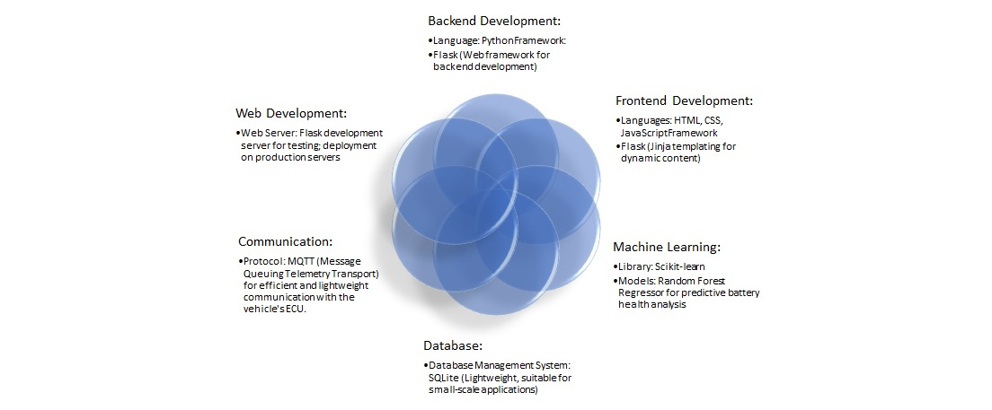

Slide 9
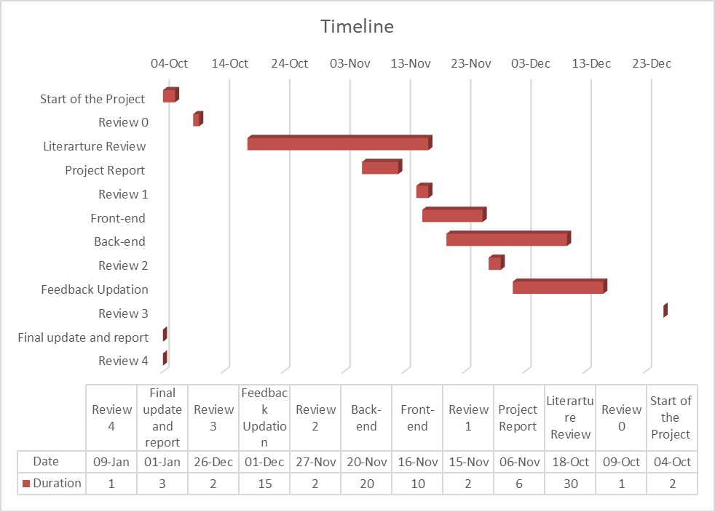
Timeline of Project

Slide 10
Outcomes / Results Obtained
The model can offer predictions of the battery's health over time, indicating the expected remaining useful life or degradation level.
Early warnings or alerts can be generated when the model detects signs of accelerated degradation, allowing for proactive maintenance.
The model may recommend adaptive charging strategies to optimize the battery's charging patterns, promoting longevity.
Based on the predicted health, the model could suggest operational changes to improve battery life, such as adjusting usage patterns or avoiding extreme environmental conditions.
Estimates of when the battery may need replacement or major maintenance can be provided, aiding in budgeting and resource planning.

Slide 11
Conclusion
In conclusion, the "Intelligent Battery Management System" represents a revolutionary solution, systematically addressing diverse aspects of battery optimization and management. Through the seamless integration of machine learning models, the system excels in predictive and proactive battery health management, leading to a significant reduction in unexpected breakdowns and an extension of the battery lifespan. The implementation of adaptive charging strategies ensures optimal charging rates, mitigating the risks of overcharging and minimizing degradation. The system's dynamic load management capabilities, particularly advantageous for electric vehicles and renewable energy systems, contribute to efficient energy distribution. The user-friendly interface enhances accessibility, enabling users to effortlessly monitor battery health and receive personalized recommendations. Additionally, the integration of advanced fault detection and diagnostics, coupled with timely alerts and notifications, enhances the overall reliability of the system. These accomplishments collectively position the "Intelligent Battery Management System" as a trailblazer in sustainable and dependable energy practices, setting the stage for future innovations in battery management technologies.

Slide 12
References
Optimized Random Forest Regression Model for Li-Ion Batteries. Batteries, By Wang, G. (2022).
State of Health Estimation for Lithium-ion Batteries Based on Mechanism Fundamental Learning under Variable Charging Strategy. By Shang, Y. (2023)
Predictive Maintenance of Automotive Batteries: A Comprehensive Review. International Journal of Automotive Technology. By Gupta, V., Patel, S. (2022)
Algorithmic Approaches for Vehicular Health Prediction. IEEE Transactions on Vehicular Technology. By Sharma, A., Kapoor, R. (2021)
A Comparative Analysis of Smart Solutions for Vehicular Maintenance. International Conference on Intelligent Transportation Systems. By Singh, M., Verma, P. (2020).
State of Health Trajectory Prediction Based on Multi-Output Gaussian Process Regression for Lithium-Ion Battery. Batteries, 8(10), 134. By Wang, J., Deng, Z., Li, J., Peng, K., Xu, L., Guan, G., & Abudula, A. (2022).
An Unscented Kalman Filter-Based Robust State of Health Prediction Technique for Lithium-Ion Batteries. Batteries, 9(7), 376. By Ranga, M. S., Aduru, V. R., Krishna, N. V., Rao, K. D., Dawn, S., Alsaif, F., Alsulamy, S., & Ustun, T. S. (2023).
Identification of the typical sub-health state of traction battery based on a data-driven approach. Batteries, 8(3), 65. By Wang, C., et al. (2022)
State of health estimation method for electric vehicle Li-Ion. By Zhi, Y. (2018)
Cloud-to-Edge Based State of Health Estimation Method. By Wu, J. (2018)

Slide 13
Publication Details
Online research paper & blog publisher – https://www.irjmets.com/
Model publisher – GitHub

Slide 14

Thank You

